Slide 1
Azure App Service to Create Web and Mobile Apps
Ken Cenerelli
@KenCenerelli
#CloudDevConf, #AppService

Slide 2





About Me
Ken Cenerelli
Bio:
Content Developer / Programmer Writer
Microsoft MVP - Visual Studio and Development Technologies
Microsoft TechNet Wiki Guru
Co-Organizer of CTTDNUG
Technical reviewer of multiple books
CTTDNUG
Twitter: | @KenCenerelli
Email: | Ken_Cenerelli@Outlook.com
Blog: | kencenerelli.wordpress.com
LinkedIn: | linkedin.com/in/kencenerelli

Slide 3



















































Security & Management
Platform Services
Hybrid Operations
Portal
Compute
App Platform
Developer Services
Azure AD
Connect Health
Cloud
Services
Service
Fabric
Web Apps
API
Apps
API
Management
Visual Studio
Azure SDK
Active
Directory
AD Privileged
Identity Mngt
Batch
Remote App
Mobile
Apps
Logic
Apps
Notification
Hubs
Team Project
Application
Insights
Multi-Factor
Authentication
Backup
Integration
Analytics & IoT
Data
Automation
Operational
Insights
Storage
Queues
Biztalk
Services
SQL Data
Warehouse
HDInsight
Machine
Learning
SQL
Database
Key Vault
Hybrid
Connections
Service
Bus
Import/Export
Store /
Marketplace
Data
Factory
Event
Hubs
Redis
Cache
Search
Media & CDN
Site
Recovery
Stream
Analytics
Mobile
Engagement
DocumentDB
Tables
VM Image Gallery
& VM Depot
Media
Services
Content Delivery
Network (CDN)
StorSimple
Infrastructure Services
Compute
Storage
Networking
Windows
Linux
Containers
BLOB Storage
Azure Files
Premium Storage
Virtual Network
Load Balancer
DNS
Express
Route
Traffic Manager
VPN Gateway
Application Gateway

Slide 4
One Integrated Offering
Azure App Service
Unique integrated offering
Build rich, engaging & intelligent apps
Scale as your business grows
Notes:
Websites and Mobile Services became Web Apps and Mobile Apps

Slide 5

Azure App Service
Web Apps
Mobile Apps
Web apps that scale with your business
Build Mobile apps for any device
LOGIC Apps
Api Apps
Automate business process across SaaS and on-premises
Easily build and consume APIs in the cloud
Notes:
App Service has everything you need to build apps that target both web and mobile clients from a single app back-end.
Using API Apps, you can connect your app to dozens of popular services like Office 365 and salesforce.com in minutes, and integrate your own APIs so they can be used within any app.
And finally with Logic Apps, you can automate business processes using a simple no-code experience.

Slide 6
Azure App Service
One price

Slide 7
APP SERVICE
End-to-end car dealership example
Customer books appointment
Service Advisor assigns a technician
Service Technician closes out service work
Web Apps
LOGIC Apps
Mobile Apps
Api Apps

Slide 8



Web Apps
LOGIC Apps
Mobile Apps
Customer Site
Service Advisor
Customer Appointment
Technician App
Api Apps
http
SQL

Slide 9
Benefits of App Services
Automatic OS patching
Enterprise-grade security
High availability
Automated scale out/in
Built-in load balancing
Supports many languages and platforms
.NET, Node.js, Python, PHP, Ruby and much more
Easy continuous deployment
Continuous delivery from third-party source control providers
Built-in Git repo

Slide 10

WEB APPS

Slide 11
Full capability set available including:
.NET, Node.js, Java, PHP, and Python
WebJobs for long running tasks
Integrated VS publish, remote debug…
CI with GitHub, BitBucket, VSO
Auto-load balance, Autoscale, Geo DR
Virtual networking and hybrid connections
Site slots for staged deployments
Web Apps
Web apps run as-is
no changes required

Slide 12
APP SERVICE WEB APP ARCHITECTURE
Deployment
Server(s)
File Server
Publish Endpoint
Blob Storage
Application Database
Frontend (IIS ARR)
Microsoft Azure
Load Balancer
Metering
Runtime Database
API Endpoint

Slide 13
MOBILE APPS

Slide 14
New capabilities for Mobile apps:
WebJobs for long running tasks
CI with GitHub, BitBucket, VSO
Auto-load balance, Autoscale, Geo DR
Virtual networking and hybrid connections
Site slots for staged deployments
Push Notifications, Notification Hubs
Authentication via OAuth Identity Providers
Mobile Apps
Mobile services plus
a whole lot more

Slide 15



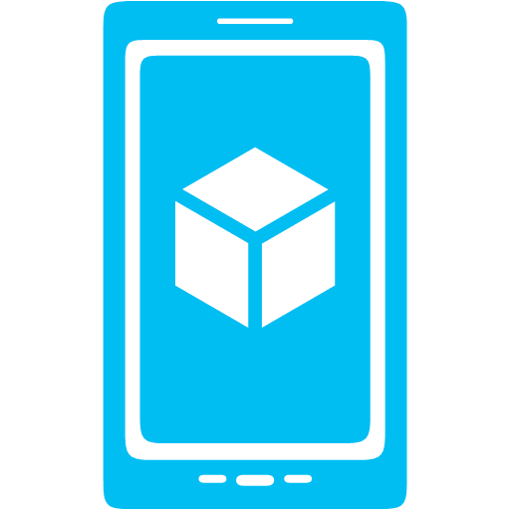



Azure Mobile Apps
Storage
Authentication
Logic
Push
Scheduler
Notes:
Speaking Notes
Azure Mobile Apps is a Backend-as-a-Service
Instead of you having to design, build, test, deploy, manage, and upgrade your whole backend, Azure does it for you
Features of Mobile Services
Storage – SQL DB
Authentication – built-in support for social providers w/ ability to do custom auth
Backend logic – data validation, logical flows, etc.
Push Notifications – across all major mobile platforms
Scheduler – backend job processing

Slide 16
Structured Storage
Powered by SQL Database
Supports rich querying capabilities
Dynamic Schematization
Data management in:
Azure Portal
SQL Portal (Silverlight)
SQL Management Studio
REST API
Azure CLI Tools
SQL CLI
Notes:
Speaking points
Mobile Services easily connects to SQL Database
SQL offers rich querying and indexing capabilities
Dynamic Schematization means you don’t have to be a DBA and manage schema
Data can be managed in:
Azure Portal (read and delete data)
SQL Portal (Silverlight)
SQL Management Studio (Windows)
REST API (used by SDKs)
Azure CLI tools
SQL CLI (Node module)

Slide 17
DEMO: WEB APP & MOBILE APP

Slide 18
LOGIC APPS

Slide 19
New Logic Apps for easy automation
No code designer for rapid creation
Drag and Drop
Dozens of pre-built templates to get started
Out of box support for popular SaaS and on-premises apps
Use with custom API apps of your own
BizTalk APIs for expert integration scenarios
LOGIC Apps
Automate SaaS and
on-premises systems
Notes:
Logic Apps are the connectors to APIs and puts it in a business workflow that can scale
Business processes and things that change often; might live in BizTalk

Slide 20
CONNECT AND AUTOMATE COMMON TASKS WITH LOGIC APPS
Use simple, intuitive tools
Create crucial, reliable tasks without coding
Integrate your mobile and web-based apps
Connect existing apps to SaaS services
BizTalk APIs for expert integration scenarios

Slide 21
SAAS INTEGRATION

Slide 22
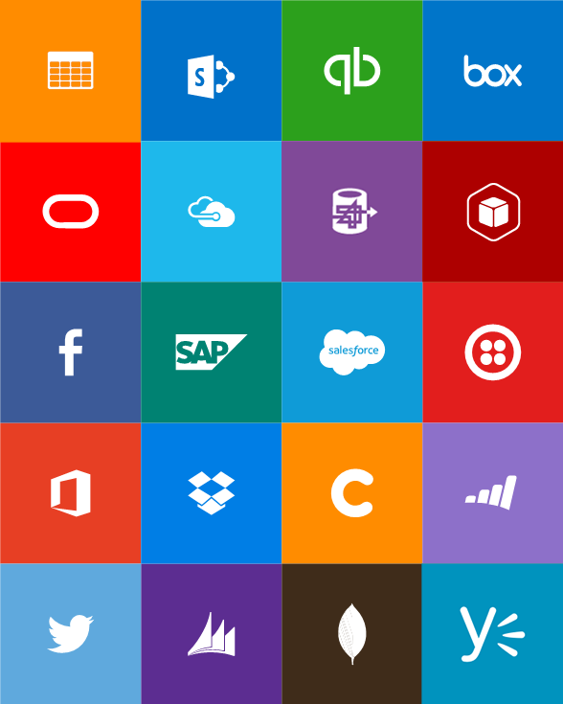
BUILT-IN API CONNECTORS
Connectors
Box
Chatter
Delay
Dropbox
Azure HD Insight
Marketo
Azure Media Services
OneDrive
SharePoint
SQL Server
Office 365
Oracle
QuickBooks
SalesForce
Sugar CRM
SAP
Azure Service Bus
Azure Storage
Timer / Recurrence
Twilio
Twitter
IBM DB2
Informix
Websphere MQ
Azure Web Jobs
Yammer
Dynamics CRM
Dynamics AX
Hybrid Connectivity
Protocols
BizTalk Services
HTTP, HTTPS
File
Flat File
FTP, SFTP
POP3/IMAP
SMTP
SOAP + WCF
Batching / Debatching
Validate
Extract (XPath)
Transform (+Mapper)
Convert (XML-JSON)
Convert (XML-FF)
X12
EDIFACT
AS2
TPMOM
Rules Engine

Slide 23
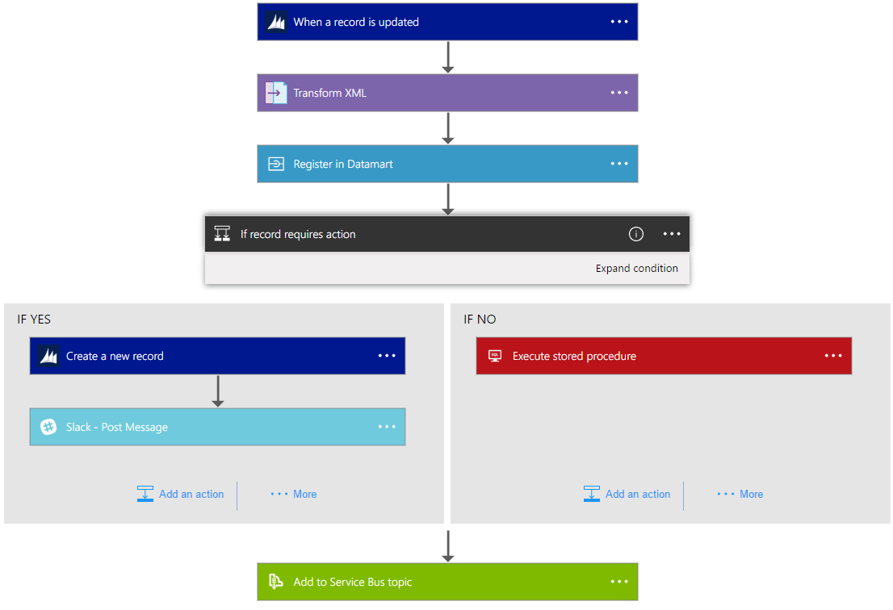
Example Logic App
Notes:
Speaking points
Dynamics CRM record created
XML transform
Register in a datamart
Create new record in Dynamic CRM and post record to Slack OR do something in SQL
Add a Service Bus topic

Slide 24
DEMO: LOGIC APP

Slide 25
API APPS

Slide 26
Easily use cloud or custom APIs:
Dozens of built-in APIs for popular SaaS
An ecosystem of APIs for any need
Create and publish custom, reusable APIs
Visual Studio tooling with one-click publish and remote debugging
Automatic client SDK generation for many languages
Api Apps
Create, consume and
host APIs more easily
Notes:
API Apps are for Twitter, Dropbox; uses open standards
Swashbuckle adds Swagger to APIs; installed automatically
API Apps get generated as NuGet packages
Bring the API out of NuGet then I host that instance; control when to update it; scale it; choose to auto update it - will go live it by itself
API Apps run in your portal (Slack, Twitter); I need to manage it
Publish Target Microsoft Azure API Apps (10 free apps like before)

Slide 27
Benefits of API Apps
Bring your API as-is
.NET Web API
Node.js + Express
Java
PHP
Many other technologies
Connect easily to SaaS platforms

Slide 28
Consuming API Apps
API Apps expose HTTP services
Metadata is exposed using Swagger 2.0 metadata
JSON file
Widely supported
Client applications

Slide 29
DEMO: API APP

Slide 30
CONTINUOUS DELIVERY
WITH APP SERVICE

Slide 31
Continuous integration

Slide 32

Continuous Deployment for Web Apps
Web App Production Slot
Agility through Continuous Deployment
Auto-Swap
Hooks
Git pull
Commits
Changes
Web App Staging Slot
Source Control / Code Repo
Developer

Slide 33

STAGING

Slide 34
STAGING

Slide 35
STAGING

Slide 36
STAGING

Slide 37

Source Control for Web/API/Mobile Apps
Git
Visual Studio
Online
CodePlex
GitHub
BitBucket
DropBox
FTP
Choose your own adventure!

Slide 38

PRICING

Slide 39
App Service Plans
An App Service Plan represents a set of features and capacity that you can share across multiple apps in Azure App Service, including Web Apps, Mobile Apps, Logic Apps or API Apps.

Slide 40
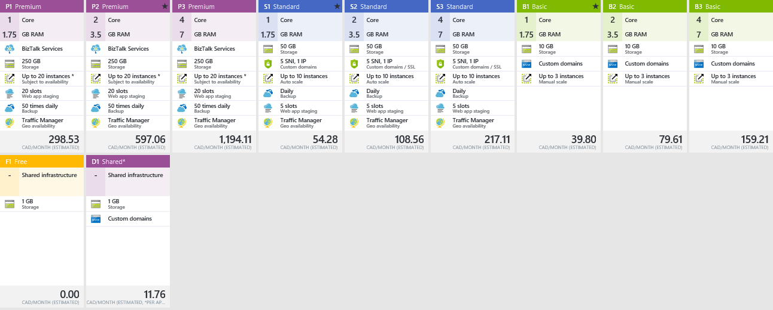
App Service Plan Pricing Tiers

Slide 41
Summary
Run mission-critical web and mobile apps
Scales with your business
Focus on what’s important to you and your application
Let Microsoft take care of the infrastructure

Slide 42
Resources
Try Azure App Service: tryappservice.azure.com
Code Samples: azure.microsoft.com/en-us/documentation/samples
Docs & Tutorials: azure.microsoft.com/en-us/documentation/services
Best Practices: azure.microsoft.com/en-us/documentation/articles/app-service-best-practices

Slide 43

Credit: https://www.flickr.com/photos/slightlyblurred/9235803926/

Slide 44

Questions?
@KenCenerelli
Ken_Cenerelli@Outlook.com

